Slide 1
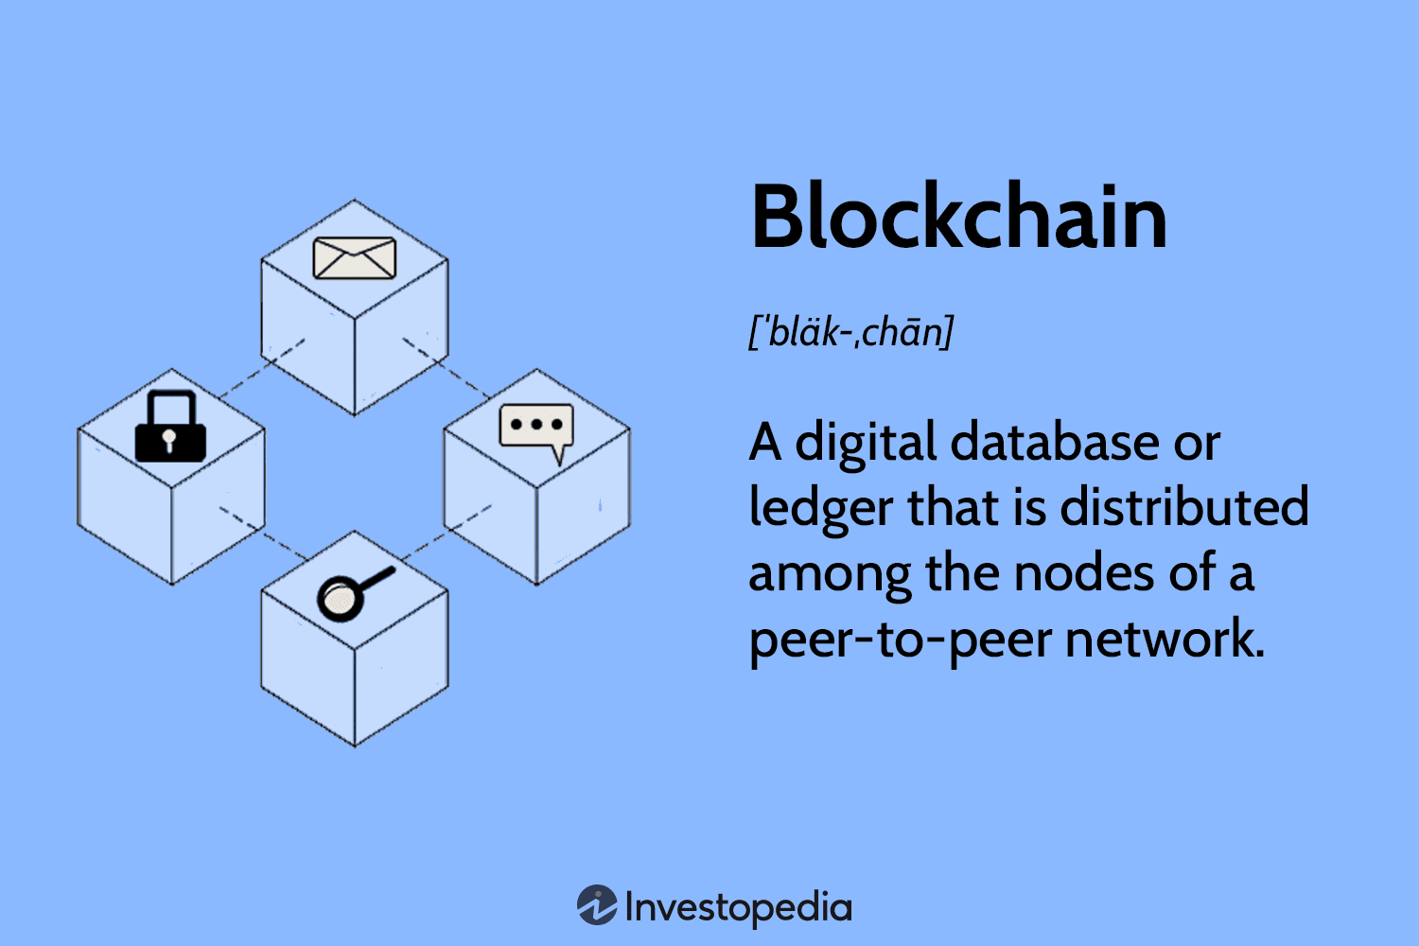
Blockchain 101
Blockchain is a decentralized digital ledger that records transactions across multiple computers. It provides transparency, security, and immutability. However, as blockchain networks grow, scalability becomes a challenge, leading to slower transactions and higher costs. Layer 2 solutions are technologies built on top of existing blockchains, like Ethereum, to address these scalability issues. They offer more efficient and cost-effective ways to process transactions, enabling faster speeds and lower fees while maintaining the security benefits of the underlying blockchain.

Slide 2
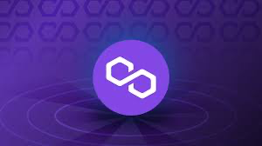
Blockchain 101
Polygon achieves faster transaction speeds and lower fees compared to Ethereum, even with Ethereum's transition to Proof of Stake (PoS), due to its unique architecture and design choices. By moving transactions off the main Ethereum chain and onto Polygon's sidechain, the burden on the Ethereum network is reduced, resulting in improved scalability and faster transaction processing. Polygon utilizes a modified PoS consensus mechanism, known as the PoS sidechain, which is specifically optimized for high throughput and fast transaction finality.

Slide 3
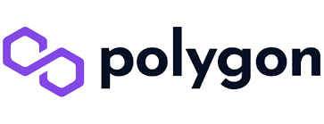
Why Polygon?
Polygon, the chosen network of leading platforms Twitter and Stripe, offers engineers and business people a compelling solution for crypto payments. Stripe, renowned for its digital payment expertise, selected Polygon due to its key attributes. These include low fees, rapid transaction speeds, seamless integration with Ethereum, and broad compatibility with various wallets. With Polygon, users benefit from cost-effective transactions, lightning-fast speeds, enhanced Ethereum connectivity, and the freedom to choose their preferred wallet. This partnership underscores Polygon's appeal as a transformative platform for efficient and accessible digital payments.

Slide 4
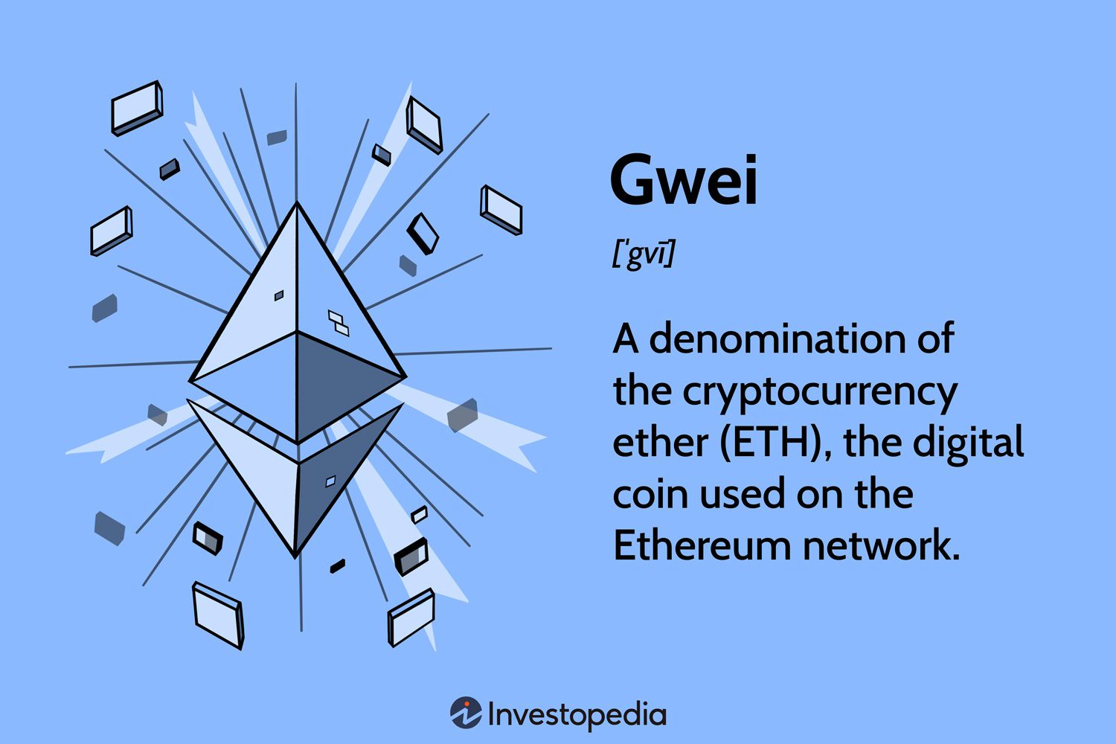
Why Polygon?
If you've ever experienced the sluggishness and high costs associated with transactions on the Ethereum mainnet, you're well aware of the scalability problem plaguing the blockchain industry. However, the tides are turning as innovative technologies, known as Layer 2 solutions, are reshaping the landscape, empowering wider user adoption.

Slide 5
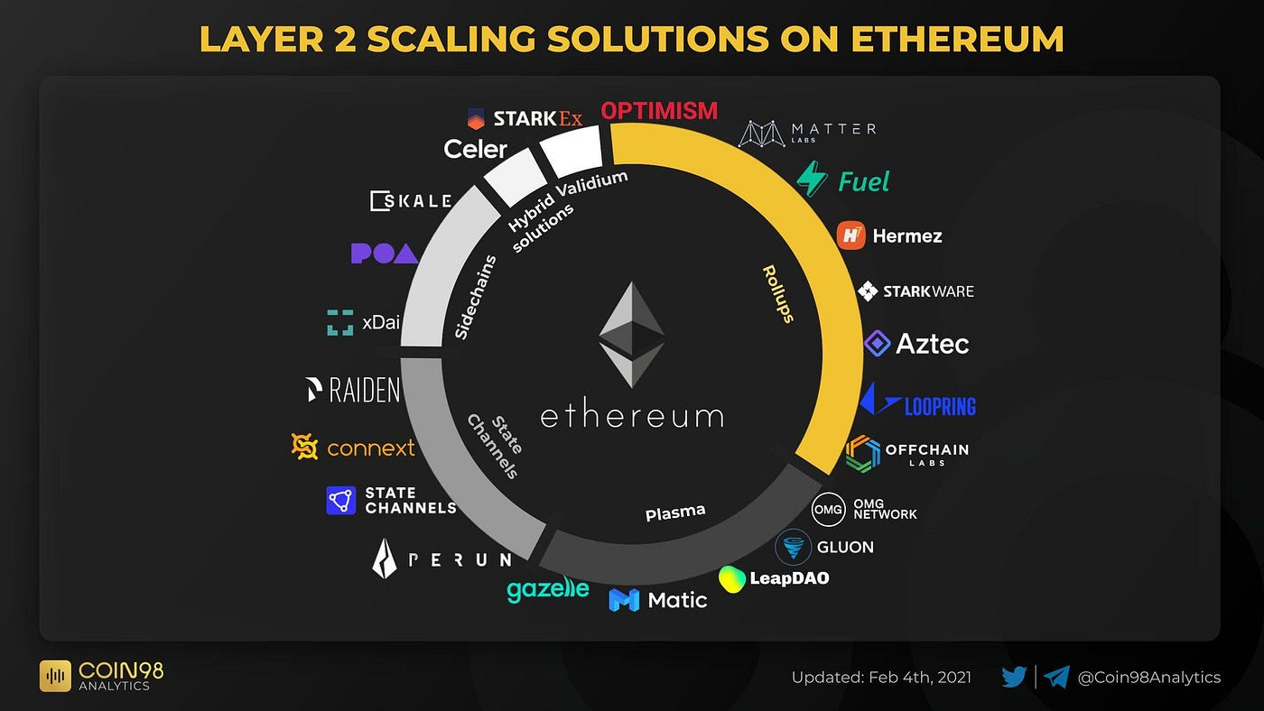
Why Polygon?
Layer 2 solutions act as transformative layers built atop Layer 1 blockchains, such as the Ethereum mainnet, to enhance their usability and performance. These solutions harness the power of ingenuity to tackle the scalability issue head-on, paving the way for an enhanced user experience.

Slide 6

Polygon - The Sidechain
Bridges 🌉: These powerful tools facilitate the seamless transfer of tokens between different layers and blockchains. By enabling interoperability, bridges break down barriers and enhance connectivity, allowing users to navigate the blockchain ecosystem with ease.

Slide 7
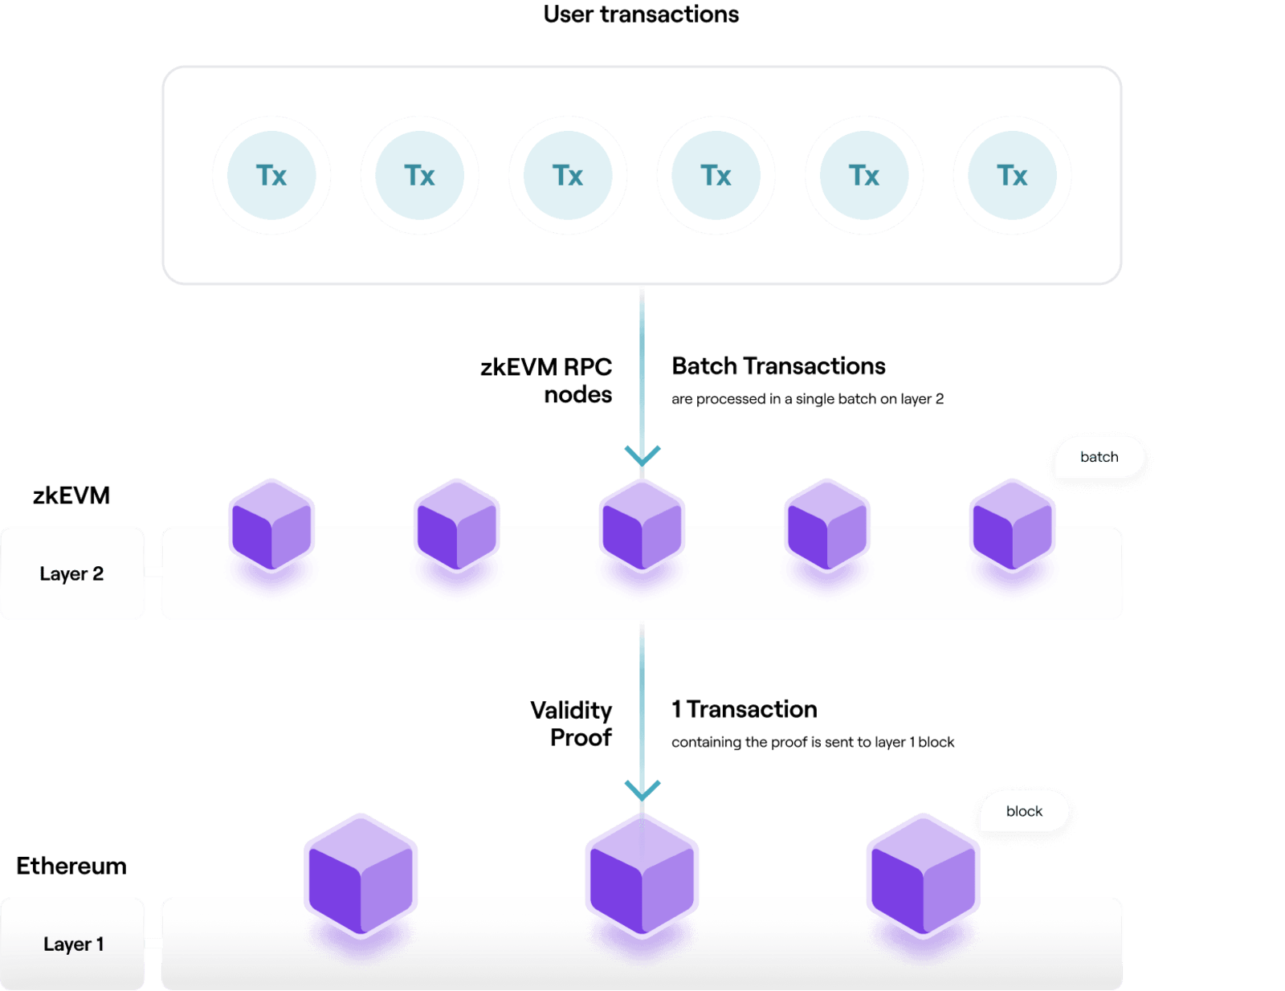
Polygon - The Sidechain
Roll-ups 🗞: A transformative solution, roll-ups significantly reduce transaction costs while maintaining high levels of security. By consolidating multiple transactions into a single batch, roll-ups enhance efficiency and affordability, revolutionizing the landscape of blockchain operations.

Slide 8
Polygon - The Sidechain
Sidechains 🔗: Offering increased scalability and efficiency, sidechains amplify the potential of blockchain technology. They provide an additional layer to the existing blockchain infrastructure, expanding capacity and enabling a wide range of applications with improved performance.

